Slide 1
Financial Reporting & Financial Statement Analysis Sem-VI Financial Statement Analysis
Chiranjit Ghosh
Department of Commerce

Slide 3
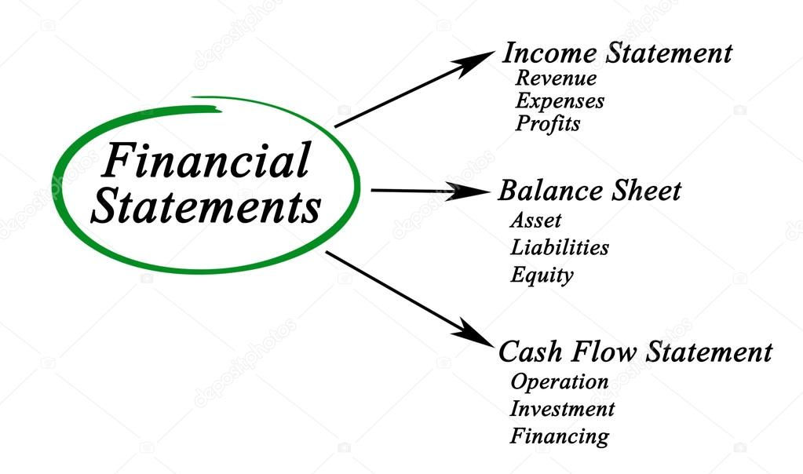

Slide 4
The process of identifying the strength & weakness of the concern by the truly setting up the relationship between the items that are usually contained in the financial statements
FINANCIAL STATEMENT ANALYSIS

Slide 5
NEEDS OF FINANCIAL STATEMENT ANALYSIS
Investment Decision
Assessment of Liquidity
Assessment of operating Excellence
Assessment of Profitability
Assessment of Performance
Managerial Decision
Allocation of Resources

Slide 6
Parties to Financial Statement Analysis
Management
Proprietor/Shareholders/Partners
Creditors
Bankers
Other Lenders
Government
Customers
Employees

Slide 7
Modern Approach to Financial Statement Analysis
Comparative Statement
Common-size Statement
Trend Analysis
Fund Flow Statement
Cash Flow Statement
Ratio Analysis
Budgetary Control

Slide 8
Comparative Statement Analysis
Comparative Statement or Comparative Financial Statement refers to a comparative study of components or elements or items of financial statements (Balance Sheet & Income Statement) for two or more years or with that of other entities. It is a historical summary of the same item or group of items of consecutive Income Statement or Balance Sheet of an entity.

Slide 9
Advantages of Comparative Statement
For Evaluation of Financial Performance
Earmarked Changes
Highlighting nature of changes
Indicating Strength & Weakness
Comparison with other entities
Helps to make Forecasting & Planning
Key Financial Statistics
Key Help in Decision Making
Trend Analysis

Slide 10
Disadvantages of Comparative Statement
Historical records
Price Level Changes
Difficult to make Inter-firm Comparison
Difficult to make detailed analysis
Chance of providing Misleading information

